Slide 1
Gradient Optimization Techniques for Neural Networks
Rajuladevi Manikyam Aishwarya
Channadi Sakshitha
Induri Bhavya
Bhuvanapalli Divya

Slide 2
Aim
Study of different intuitions and behaviors of gradient optimization techniques
Implementation
Building a thee layer fully connected neural network

Slide 3
Dataset
Fashion-MNIST dataset is used to test the model
Algorithms used
Polyak’s classical momentum
Nestrov’s accelerated gradient
Adagrad
Adadelta
RMSprop
Adam
Adamax
Nadam
AMAgrad

Slide 4
Design
Three-layer fully connected neural network : one input layer, two hidden layers and one output layer
Training dataset : 50,000 samples
Validation : 10,000 samples
Initialization of weights and biases and multiplying them by a factor of 0.01
Forming minibatches from the train and validation datasets
Gradient descent: Implementation of ReLU and linear activation functions for L-1 layers and softmax function through network
Optimization techniques

Slide 5

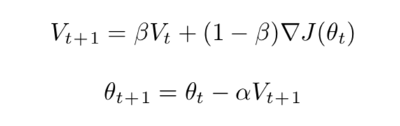
Techniques of Gradient Descent
No Momentum
Basic technique of Gradient Descent
Each minibatch undergoes forward prop, loss function, and back prop
Polyak’s Classical Momentum
Gradient descent with momentum ( stochastic optimization technique)
Defining momentum – moving average of the gradients

Slide 6
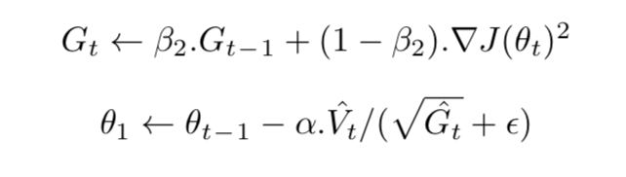
RMSprop
Adaptive learning rate gradient-based optimization technique
Dervied from Adagrad
Adapts learning rate by performing updates based on the frequency of the occurrence of features
RMSprop divides the learning rates by an exponentially decaying average of the squared gradients

Slide 7
Adam
Stochastic optimization method closely related to RMSprop and Adadelta
Require: α : Stepsize Require: β1 , β2 ∈ [0, 1) : Exponential decay rates
Require: f (θ) : Stochastic objective function Require: θ0 : Initial parameter vector
V0 ← 0 (Initialize first moment vector)
G0 ← 0 (Initialize second moment vector) t0 ← 0 (Initialize timestep) while θt not converged do
t←t+1
∇J(θt) ← ∇θft(θt − 1) (Get Gradients)
Vt ← β1.Vt − 1 + (1 − β1).∇J(θt) (Update biased first estimate)
Gt ← β2.Gt − 1 + (1 − β2).∇J(θt)2 (Update biased second raw moment estimate )
Vˆ ← V /(1 − βt ) (Compute bias-corrected first moment tt1 estimate)
Gˆt ← Gt /(1 − β2t ) (Compute bias-corrected second raw moment estimate)
θ ← θ − α.Vˆ /(􏰀Gˆ + ε) (Update parameters)
end while
return θt

Slide 8
Experiments
Various tests are conducted for different learning rates and mini batch sizes
Analysis of train and validation costs
For every test, training, validation and test accuracies are reported
Cost curves for learning rates are plotted

Slide 9
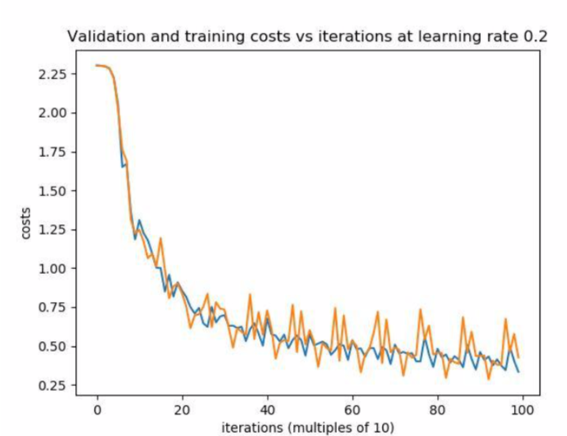
Train, Validation and test curves for the best case of NO MOMENTUM

Slide 10
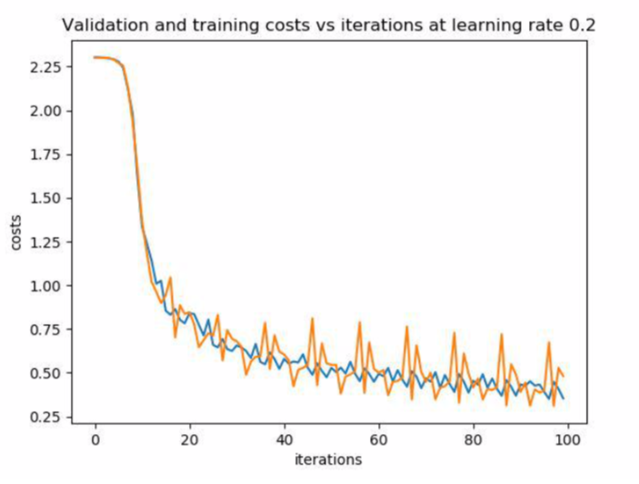
Train, Validation and test curves for the best case of MOMENTUM

Slide 11
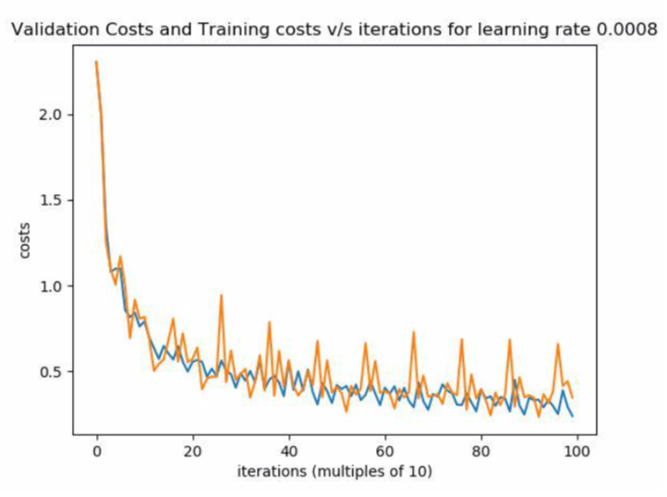
Train, Validation and test curves for the best case of RMSprop

Slide 12
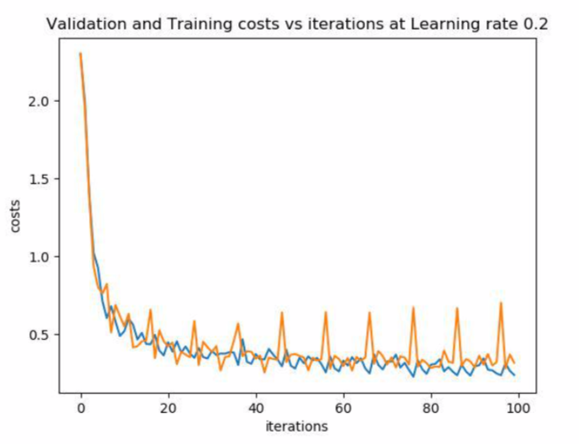
Train, Validation and test curves for the best case of Adam

Slide 13
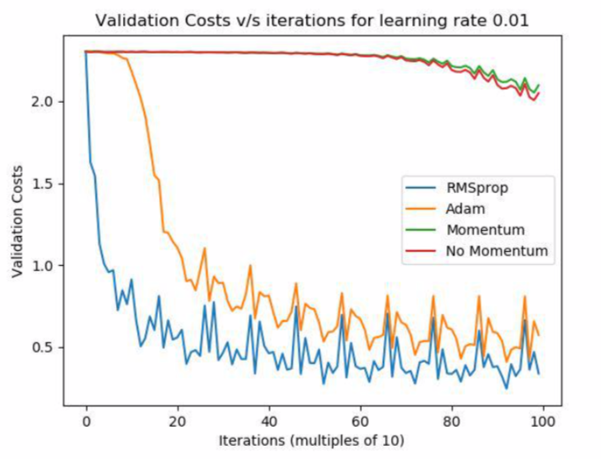
Learning rate 0.01 plot of validation costs of all techniques

Slide 14
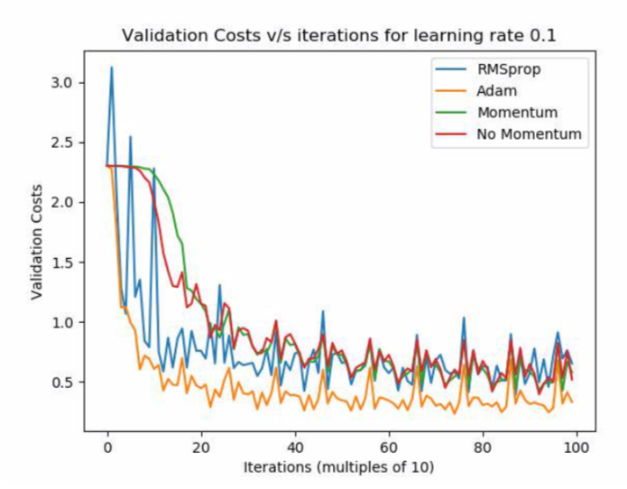
Learning rate 0.1 plot of validation costs of all techniques

Slide 15
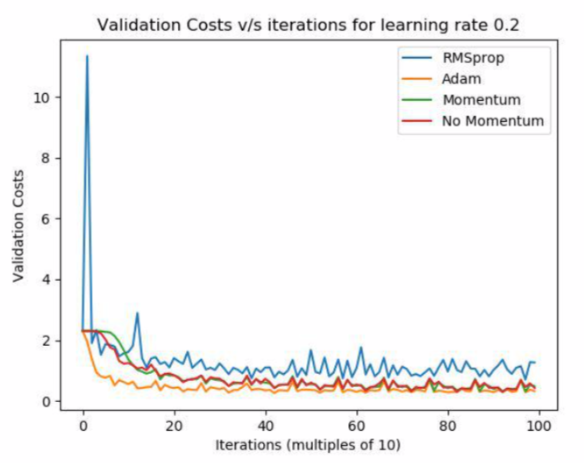
Learning rate 0.2 plot of validation costs of all techniques

Slide 16
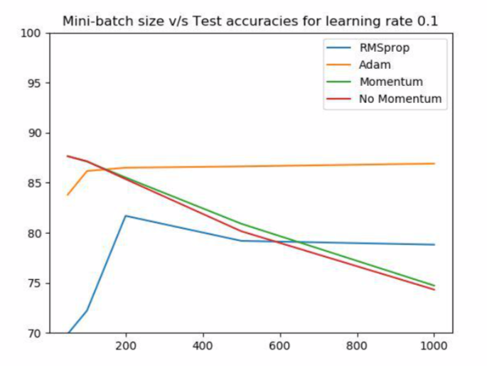
Plot of text accuracies of all the techniques for various mini-batch sizes

Slide 17
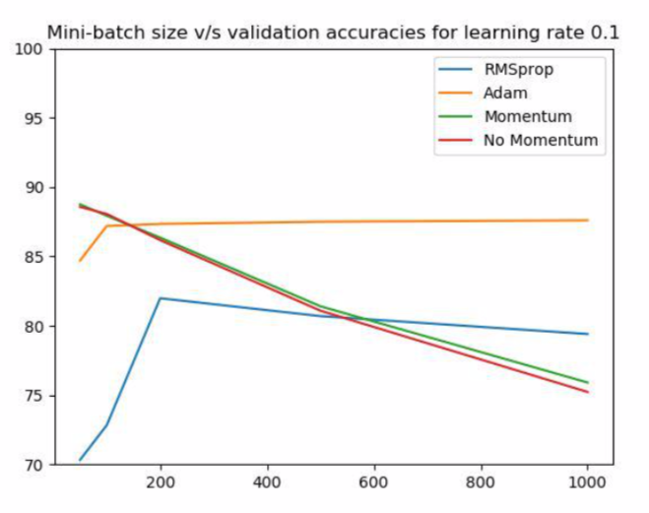
Plot of validation accuracies of all the techniques for various mini-batch size

Slide 18
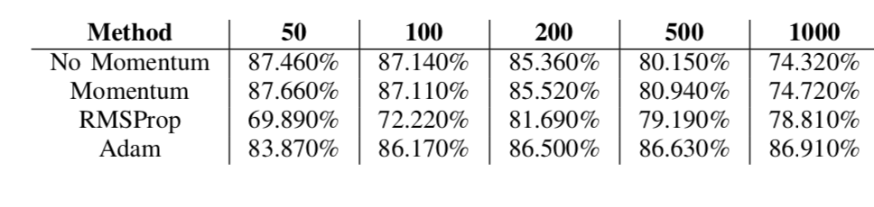
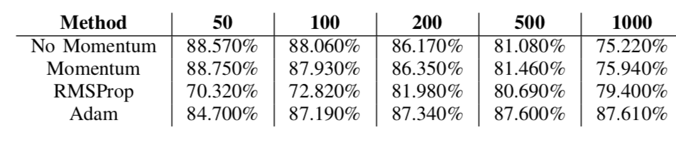
Testing accuracies for different mini-batch sizes varying from 50-1000
Validation accuracies for different mini-batch sizes varying from 50-1000

Slide 19
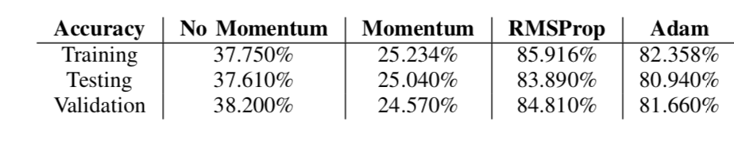
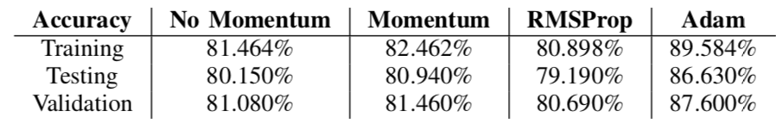
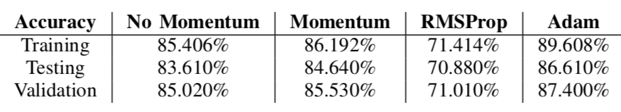
Training, testing and validation accuracies for all the techniques with learning rates 0.01
Training, testing and validation accuracies for all the techniques with learning rates 0.1
Training, testing and validation accuracies for all the techniques with learning rates 0.2

Slide 20
Conclusion
From the experiments, we can conclude that Adam optimizer is the best optimization technique with learning rate equal to 0.2
Low mini-batch size results in better model performance, whereas a larger mini-batch size implodes the ability of the model on new data.

Slide 21
THANK YOU

